Slide 1

INSTITUTE :UIE
DEPARTMENT: ALL ACADEMIC UNITS
Bachelor of Engineering (All Sections)
Subject Name and Code:
Engineering Physics 23SPH-141
Prepared by: Ms. Arminder
UNIT 3
QUANTUM MECHANICS
DISCOVER . LEARN . EMPOWER

Slide 2
COURSE OBJECTIVES
The course is designed to make the students industry ready to contribute in the growing demand of the industry at local, national and international level.
It will make the students competent to understand basic concepts and applications of advanced engineering physics and apply its principles in their respective fields at global platform.
It will enhance the skill level of the students and shall make them preferred choice for getting employment in industry and research labs.
It will give thorough knowledge of the discipline to enable students to disseminate knowledge in pursuing excellence in academic areas.

Slide 3

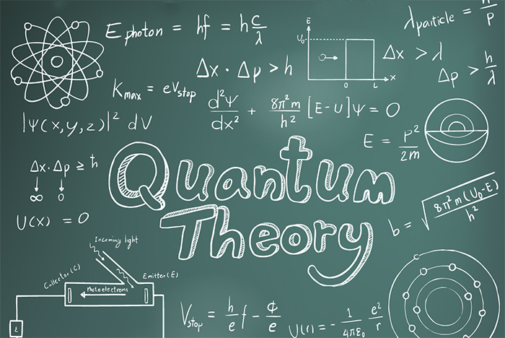
COURSE OUTCOME
CO Number | Title On completion of this course, the students are expected to learn | Level
CO1 | Quote the basic fundamental concepts of lasers, optical fibres, crystallography, ultrasonic oscillations, semiconductor physics, quantum mechanics and nanotechnology. | Remember, Understand
CO2 | Demonstrate the working of various lasers, fibre components, semiconductor devices; explain the behaviour of crystalline solids, quantum and nano-scale systems. | Understand
CO3 | Solve problems by applying principles related to lasers, fibres, semiconductors, oscillations, quantum and nanoscience. | Applying
CO4 | Compare various lasers and fibres, semiconducting devices, crystalline materials, structures at quantum and nanoscale on the basis of their properties for industrial applications. | Analyze
CO5 | Develop various systems using lasers, fibres, semiconductors and nanomaterials for futuristic applications. | Design
Figure 1 Quantum Theory [1]

Slide 4
LECTURE OBJECTIVE
1
Students will learn about matter waves.
2
Students will learn about different properties of matter waves.
3
In this lecture will derive the de Broglie wavelength in terms of energy and temperature .

Slide 5
QUANTUM MECHANICS
Figure 2.1 Quantum Theory [1]

Slide 6
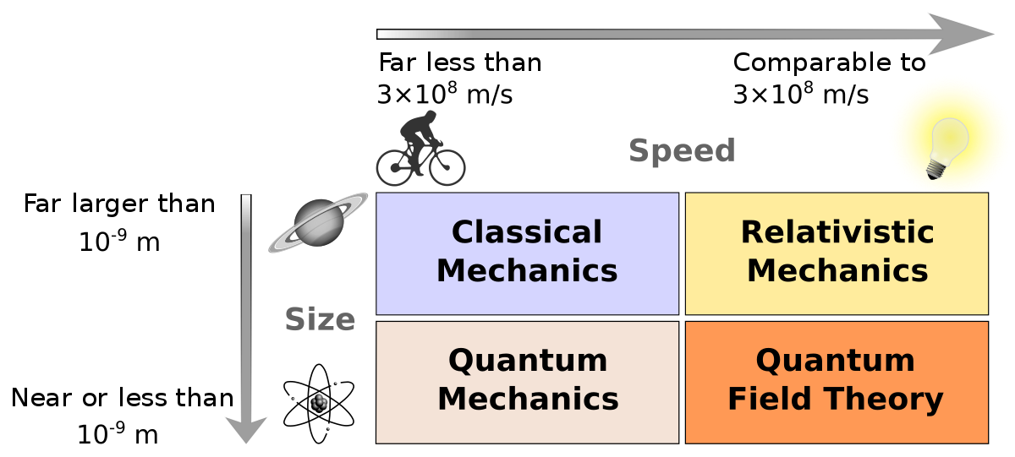
NEED OF QUANTUM MECHANICS
Problems remained from classical mechanics that relativity didn’t explain
Attempts to apply the laws of classical physics to explain the behavior of matter on the atomic scale were consistently unsuccessful.
Figure 2.2 Need of Quantum Theory [2]

Slide 7
NEED OF QUANTUM MECHANICS
Problems included:
Blackbody radiation
The electromagnetic radiation emitted by a
heated object
Photoelectric effect
Emission of electrons by an illuminated metal
Figure 2.2 Need of Quantum Theory [2]

Slide 8
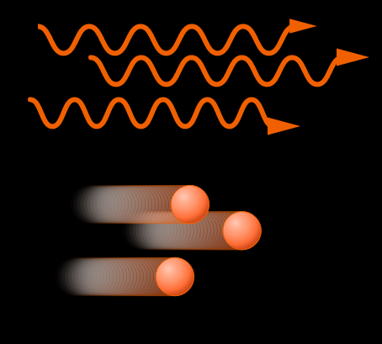
DUAL NATURE OF RADIATION
De-Broglie hypothesis proposed that if wave is having dual nature-particle and wave, particle should also possess wave characteristics
Figure 2.3 Wave and particle nature [3]

Slide 9
de-BROGLIE HYPOTHESIS
According to de-Broglie, in the universe, whole of energy appears in the form of radiation and matter. Since nature loves symmetry, if radiation which normally behaves as a wave can behave as a particle, then one can even expect that, entities like electrons, protons etc, which ordinarily behave as particle also exhibits properties of waves under appropriate circumstances. These waves associated with the matter are known as matter waves.

Slide 10
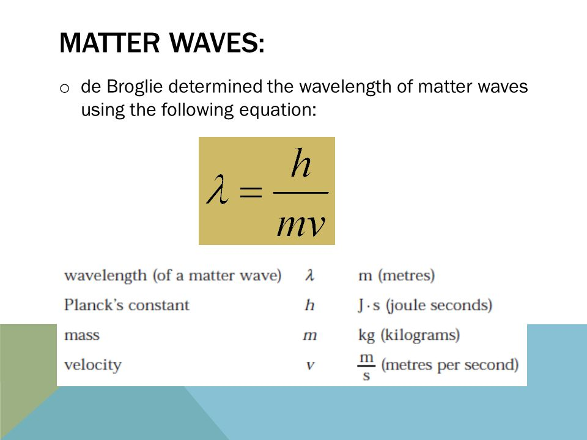
de-BROGLIE MATTER WAVES
Figure 2.4 de-Broglie matter waves [4]

Slide 11
PROPERTIES OF MATTER WAVES
Matter waves are the waves associated with matter in motion. Wavelength of the matter waves is given by λ=h/p.
Matter waves are not progressive waves. They are localized waves.
Matter waves are not single waves. They are group of waves (wave packet) assumed formed due to the superposition of two or more progressive waves.
Matter waves called pilot waves and they represent the direction of propagation of matter.
Unlike electromagnetic waves, matter waves will not have constant speed. The speed of matter waves depends on the mass of the particle.

Slide 12
de-Broglie Wavelength Of Matter Waves

Slide 13
de-Broglie Wavelength Associated With An Accelerated Particle

Slide 14
de-Broglie Wavelength Expressed In Term Of Kinetic Energy

Slide 15
de-Broglie Wavelength Associated With Particle In Thermal Equilibrium

Slide 16
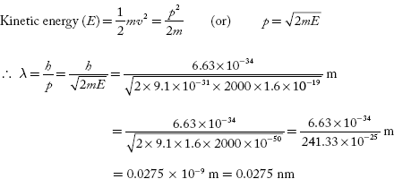
NUMERICALS
1. Calculate the wavelength associated with an electron with energy 2000 eV.
Sol: E = 2000 eV = 2000 × 1.6 × 10^{–19} J

Slide 17
NUMERICALS

Slide 18
SUMMARY
De Broglie waves are also known as matter waves.
Every moving particle has a wave associated with it.
De Broglie waves independent of charge.
Their wavelength inversely proportional to mass and velocity.

Slide 19
FAQ
Calculate the wavelength associated with an electron raised to a potential 100 V
Define DE Broglie Hypothesis.
Analyze the properties of matter waves.
Define de Broglie wavelength.

Slide 20
REFERENCES
[1] https://stradallc.com/2016/02/12/design-like-quantum-physics/
[2] https://en.wikipedia.org/wiki/Branches_of_physics
[3] http://www.sciencecalculators.org/optics/light/
[4] http://slideplayer.com/slide/7074070

Slide 21
REFERENCES
Video link
https://www.youtube.com/watch?v=JIGI-eXK0tg
https://nptel.ac.in/courses/115/102/115102023
Books
Concepts of Modern Physics, (Fifth Edition) A Beiser, McGraw Hill International.
Fundamentals of Physics, David Halliday, Robert Resnick and Jearl Walker, Wileyplus

Slide 22
THANK YOU
arminder.uis@cumail.in

